Slide 1
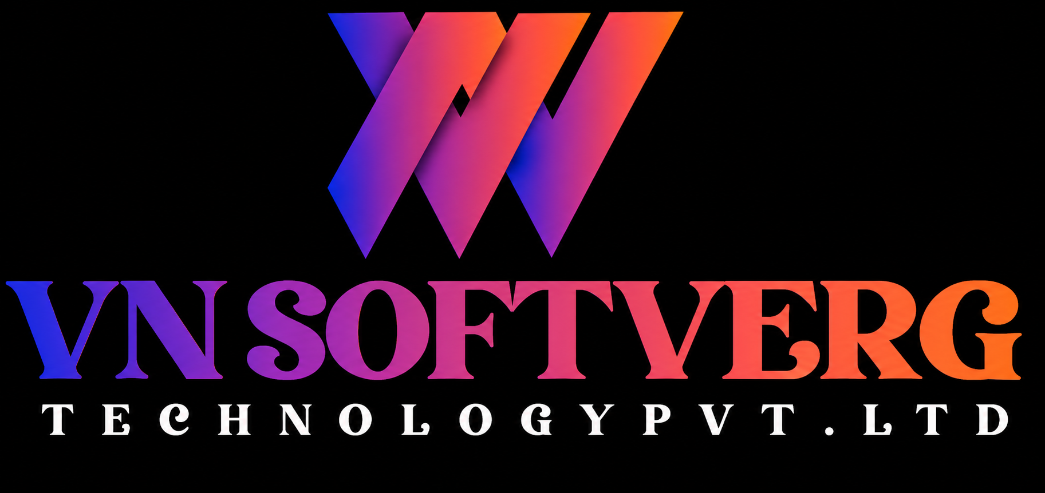
IDEAS
DEVELOPMENT
GROWTH
VN Softverg Technology
PORTFOLIO
IT & SOFTWARE SOLUTIONS
Building digital experiences that move businesses forward.
WEB / SOFTWARE / E-COMMERCE / MOBILE / UI/UX / SUPPORT
VN SOFTVERG TECHNOLOGY PVT. LTD. • HYDERABAD, INDIA
01

Slide 2
01 / ABOUT US
Technology built around your business
Practical, scalable and user-friendly solutions for startups, SMEs and growing organizations.
01
Custom-fit
02
Scalable
WHO WE ARE
Your technology partner from idea to launch.
Solutions shaped around your requirements.
Designed with future growth in mind.
VN Softverg Technology Pvt. Ltd. helps businesses build, improve and manage their digital presence through customized websites, software, e-commerce, mobile experiences and ongoing technical support.
03
Responsive
04
Support
Experiences for desktop, tablet and mobile.
Maintenance, updates and enhancements.
VN SOFTVERG TECHNOLOGY PVT. LTD. • HYDERABAD, INDIA
02

Slide 3
02 / WHAT WE DO
Core services
A flexible technology partner for digital products and business applications.
01
Website Development
02
Custom Web Applications
03
E-Commerce & Ordering
04
Restaurant Platforms
Corporate, business, restaurant, service and landing pages.
Portals, dashboards, order management, CRM and APIs.
Online stores, carts, payments, coupons and reports.
Digital menus, ordering, delivery configuration and admin tools.
05
Mobile Applications
06
UI/UX Design
07
Custom Software
08
Maintenance & Support
Customer, business, booking, ordering and service apps.
Clear, intuitive and responsive web and mobile interfaces.
Business-specific workflows and operational tools.
Technical support, updates and ongoing improvements.
VN SOFTVERG TECHNOLOGY PVT. LTD. • HYDERABAD, INDIA
03

Slide 4
03 / DIGITAL PRODUCTS
Web & software development
From a professional online presence to workflow-driven business applications.
01
Website development
02
Custom web applications
Modern, responsive websites built for credibility and a smooth user experience.
Purpose-built applications aligned to your processes and operational needs.
• Business & corporate websites
• Restaurant & service websites
• Landing pages and SEO-ready structure
• Website maintenance and support
• Customer management and admin dashboards
• Order management and booking platforms
• CRM, reporting and API integrations
VN SOFTVERG TECHNOLOGY PVT. LTD. • HYDERABAD, INDIA
04

Slide 5
04 / COMMERCE
E-commerce & online ordering
Digital channels that help businesses sell, receive orders and manage operations.
01
Customer experience
02
Admin operations
03
Business value
Simple buying journeys.
Centralized control for teams.
A flexible digital foundation.
• Browse products or menu
• Categories and customization
• Cart and checkout
• Delivery details
• UPI, cards and COD
• Order updates and offers
• Product and menu management
• Pricing and categories
• Order management
• Delivery areas and charges
• Coupon and customer management
• Sales reports
• Own digital ordering channel
• Mobile-friendly experience
• Centralized order visibility
• Flexible business rules
• Scalable architecture
• Future feature expansion
VN SOFTVERG TECHNOLOGY PVT. LTD. • HYDERABAD, INDIA
05

Slide 6
05 / SAMPLE SOLUTION
Custom food ordering platform
A sample concept for restaurants, cafés and cloud kitchens.
01
→
02
→
03
→
04
→
05
→
06
MENU
CART
CHECKOUT
PAYMENT
ORDER
DELIVERY
• Digital menu with categories, images and item customization
• Delivery-area and delivery-charge configuration
• Customer notifications, order tracking and restaurant admin reports
VN SOFTVERG TECHNOLOGY PVT. LTD. • HYDERABAD, INDIA
06

Slide 7
06 / EXPERIENCE DESIGN
Mobile applications & UI/UX
Simple, responsive and business-focused digital experiences.
01
Mobile application development
02
UI/UX design
Mobile solutions designed around specific business requirements.
Clear user journeys and intuitive interfaces.
• Customer and business applications
• Booking, ordering and service apps
• Admin applications
• API-connected experiences
• Mobile-first design
• Responsive layouts
• Dashboard design
• Website redesign
• Application UI and user-friendly workflows
VN SOFTVERG TECHNOLOGY PVT. LTD. • HYDERABAD, INDIA
07

Slide 8
07 / ENGINEERING
Technology capabilities
Technology choices aligned with project requirements, scalability and architecture.
01
Frontend
02
Backend
03
Database
04
Cloud & deployment
Core capabilities
Core capabilities
Core capabilities
Core capabilities
• HTML
• CSS
• JavaScript
• React
• Responsive web design
• PHP
• Node.js
• Python
• REST APIs
• MySQL
• PostgreSQL
• MongoDB
• Cloud hosting
• Server deployment
• Domain & hosting
• SSL
• Backup & maintenance
VN SOFTVERG TECHNOLOGY PVT. LTD. • HYDERABAD, INDIA
08

Slide 9
08 / HOW WE WORK
A clear path from idea to launch
A structured process from requirement discovery through deployment and support.
01
Requirement
02
Planning
03
UI/UX
04
Development
Understand business objectives, users and technical needs.
Define scope, features, technology and delivery plan.
Design the experience and interface around the workflow.
Build the application, database and integrations.
05
Testing
06
Deployment
07
Support
Validate functionality, responsiveness and usability.
Release to the required hosting or cloud environment.
Maintain, enhance and support the solution.
VN SOFTVERG TECHNOLOGY PVT. LTD. • HYDERABAD, INDIA
09

Slide 10
09 / WHY VN SOFTVERG
Built around the way you work
A practical, flexible approach to technology that supports business growth.
01
Customized solutions
02
Business-focused
03
Scalable architecture
Built around your requirements rather than a fixed template.
Understand the process before recommending a solution.
Designed to support future growth and new features.
04
Responsive development
05
Transparent communication
06
Flexible engagement
Experiences for desktop, tablet and mobile.
Clear updates across requirements, build, testing and launch.
Project delivery, dedicated development and support.
VN SOFTVERG TECHNOLOGY PVT. LTD. • HYDERABAD, INDIA
10

Slide 11
10 / WHO WE SERVE
Industries & engagement models
Solutions can adapt to different industries, business sizes and delivery needs.
01
Industries we support
02
Engagement models
Digital solutions for varied operating environments.
Choose a model that fits your goals and team.
• Restaurants and food services
• Retail and e-commerce
• Healthcare and education
• Real estate and logistics
• Professional services and startups
• Manufacturing, hospitality and SMEs
• PROJECT-BASED DEVELOPMENT — defined scope and deliverables
• DEDICATED DEVELOPMENT — ongoing resources for technology projects
• MAINTENANCE & SUPPORT — continuous updates and enhancements
VN SOFTVERG TECHNOLOGY PVT. LTD. • HYDERABAD, INDIA
11

Slide 12
LET'S BUILD
WHAT'S NEXT.
Your next digital solution starts here.
VN SOFTVERG TECHNOLOGY PVT. LTD.
Website • E-Commerce • Food Ordering • Web Applications • Mobile Apps • Custom Software
Hyderabad, India
Website: vnsoftvergtechnology.com
Email: info@vnsoftverg.com
Phone: 8639871800
REQUIREMENT → SOLUTION → DEVELOPMENT → DEPLOYMENT → SUPPORT
VN SOFTVERG TECHNOLOGY PVT. LTD. • HYDERABAD, INDIA
12

